Slide 1
DATA SOURCES
New Data
Youtube Videos
STACK
Storage
postgreSQL & local files on AWS RDS
Web-Tools
Website: Flask
Visualization: Plotly
Models
Python-libraries (see left)
Host
- Py-Dashboard
PROCESS – TRAINING MODEL
Collect Data
Bundestag speeches
Labelled Manifesto data
Tokenize input
CountVectorizer (turn words into vectors)
TfIDFTransformer (IDF = Inverse Document frequency > frequency of word usage)
Build Model
Logistic Regression (Classify into categories)
Grid-Search for Regularization
Train Model
Labelled Dataset
Bundestag speeches
Manifesto labelled dataset
Python Libraries
APSscheduler > used for chrono jobs
BS4 > for text parsing
Scipy
Scikitlearn
Pandas
SQLAlchemy
Pickle
Scipy
PROCESS – PREDICT IDEOLOGY FOR YOUTUBE VIDEO
Collect Data
Official data via API
Scrape text of transcript
Feed data into prediction model

Slide 2
DATA ANALYSIS
1 Problem (TAGESSCHAU)
2 Solution (THE SITE)
3 How does it work?

Slide 3
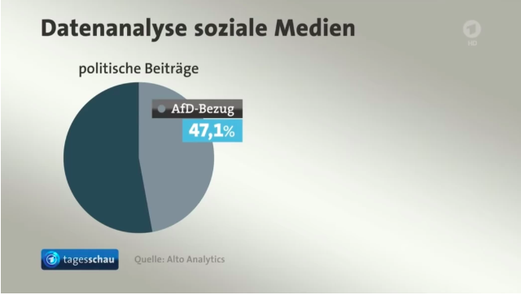
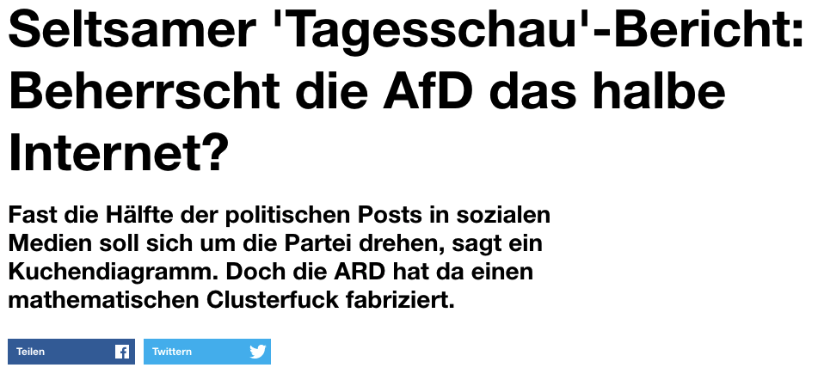
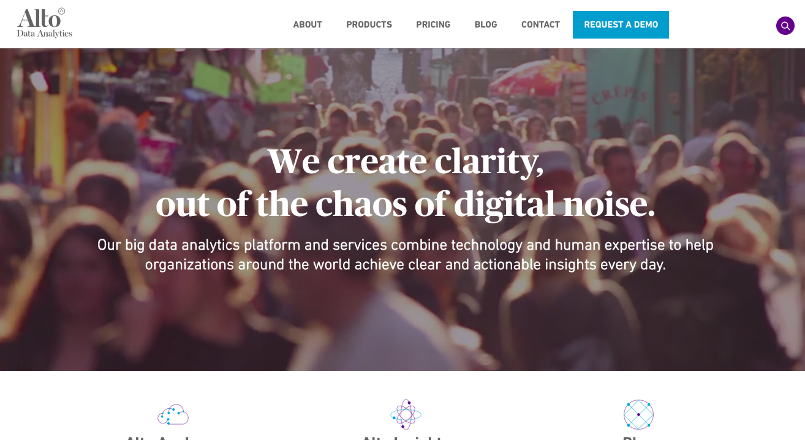

Slide 4
Architecture
Download Data
Ideology Bias Detection
Frontend
www.political-analysis.dev
Local

